Slide 1
CSY3025 Artificial Intelligence Techniques
Regression

Slide 2
https://github.com/ageron/handson-ml2/blob/master/04_training_linear_models.ipynb

Slide 3
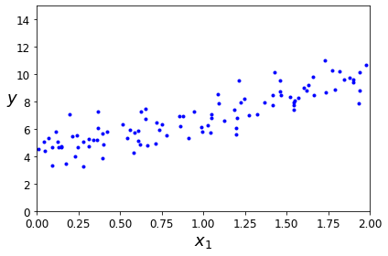
Regression
Relationship between one dependent variable and a series of other variables (independent variables)

Slide 4
Regression
Two very different ways to train it:
Using a direct “closed-form” equation that directly computes the model parameters that best fit the model to the training set (i.e., the model parameters that minimize the cost function over the training set).
Using an iterative optimization approach, called Gradient Descent (GD), that gradually tweaks the model parameters to minimize the cost function over the training set, eventually converging to the same set of parameters as the first method.

Slide 5
Regression
Linear Regression
Polynomial Regression
Logistic Regression
Softmax Regression

Slide 6
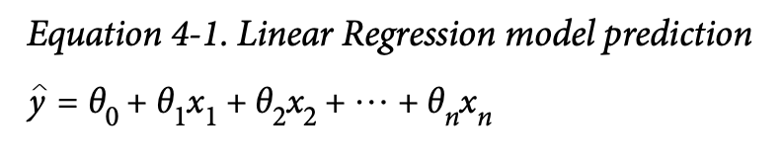
Linear Regression
a linear model makes a prediction by simply computing a weighted sum of the input features, plus a constant called the bias term (also called the intercept term)

Slide 7
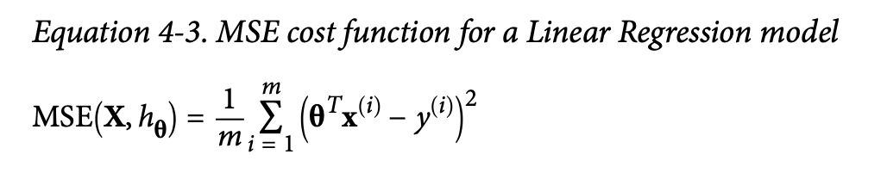

Slide 8
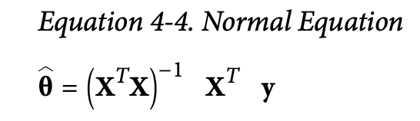
Normal Equation
To find the value of θ that minimizes the cost function, there is a closed-form solution —in other words, a mathematical equation that gives the result directly. This is called the Normal Equation
theta_best = np.linalg.inv(X_b.T.dot(X_b)).dot(X_b.T).dot(y)
[4.21509616],[2.77011339]

Slide 9
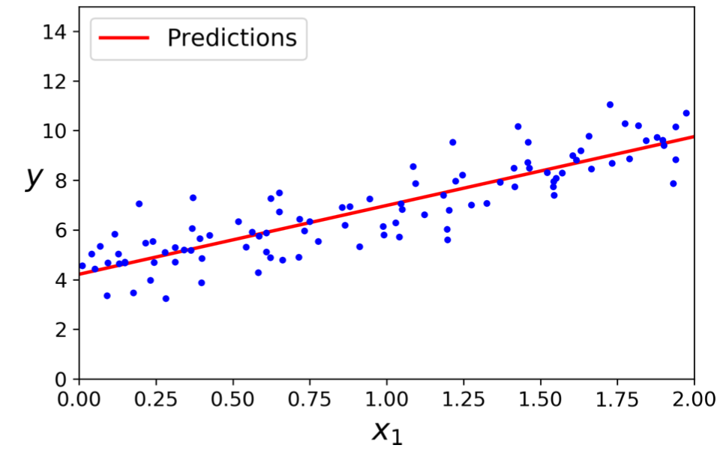

Slide 10
Linear Regression
Performing linear regression using Scikit-Learn is quite simple:
>>> from sklearn.linear_model import LinearRegression
>>> lin_reg = LinearRegression()
>>> lin_reg.fit(X, y)
>>> lin_reg.intercept_, lin_reg.coef_ (array([4.21509616]), array([[2.77011339]]))
>>> lin_reg.predict(X_new)
array([[4.21509616], [9.75532293]])
High complexity – increasing number of features

Slide 11
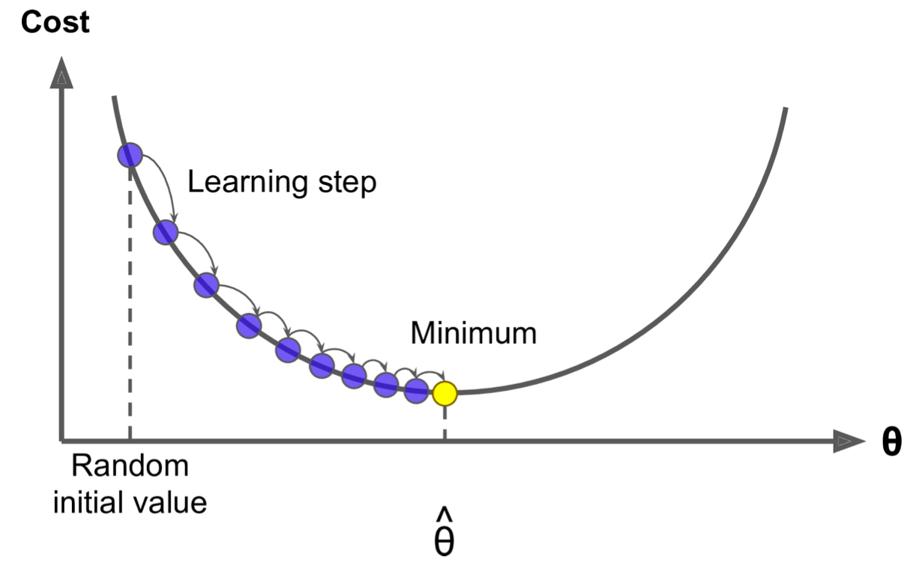
Gradient Descent
Gradient Descent is a very generic optimization algorithm capable of finding optimal solutions to a wide range of problems. The general idea of Gradient Descent is to tweak parameters iteratively in order to minimise a cost function.

Slide 12
Gradient Descent
Concretely, you start by filling θ with random values (this is called random initialization), and then you improve it gradually, taking one baby step at a time, each step attempting to decrease the cost function (e.g., the MSE), until the algorithm converges to a minimum

Slide 14
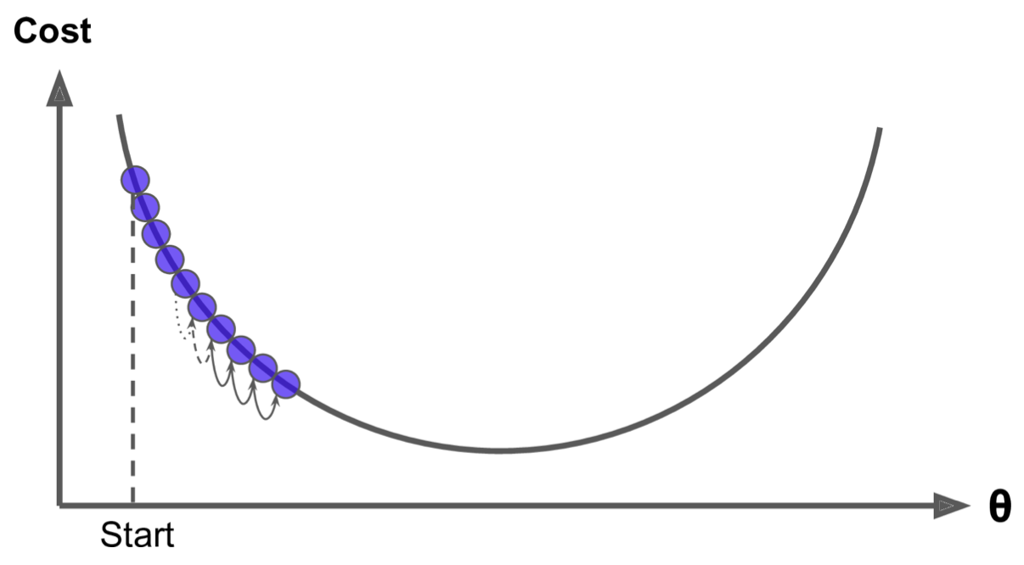
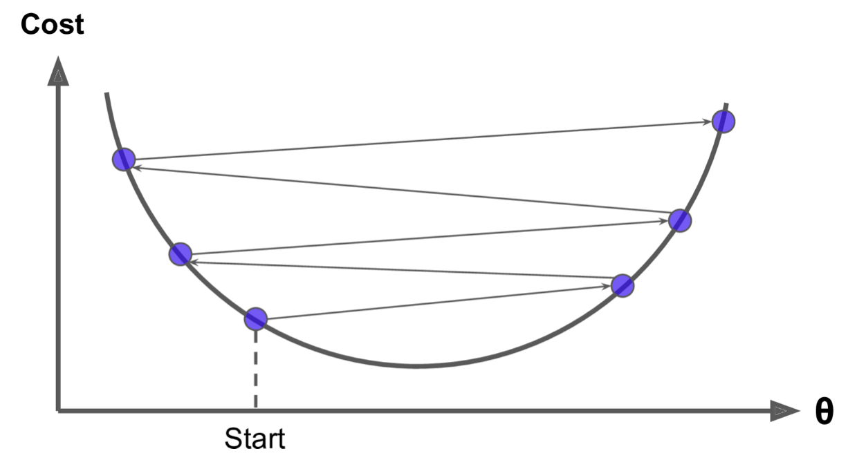
Gradient Descent
An important parameter in Gradient Descent is the size of the steps, determined by the learning rate hyperparameter.

Slide 15
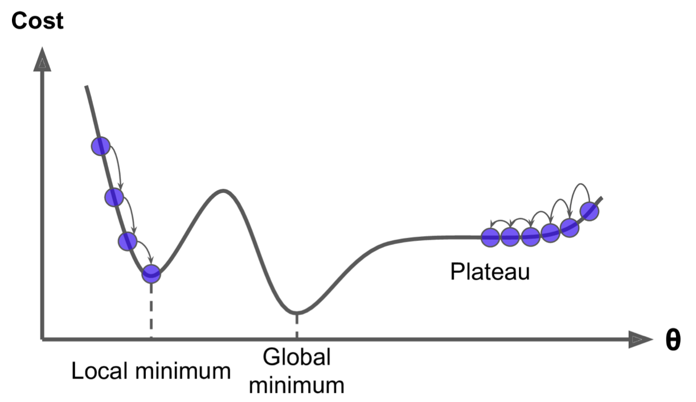
Gradient Descent
two main challenges with Gradient Descent: if the random initialization starts the algorithm on the left, then it will converge to a local minimum, which is not as good as the global minimum. If it starts on the right, then it will take a very long time to cross the plateau, and if you stop too early you will never reach the global minimum.

Slide 16
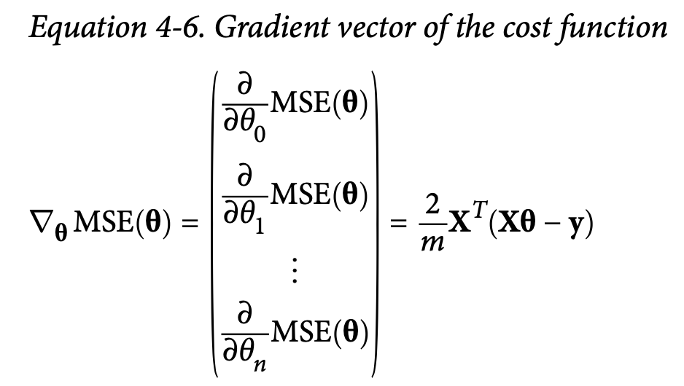
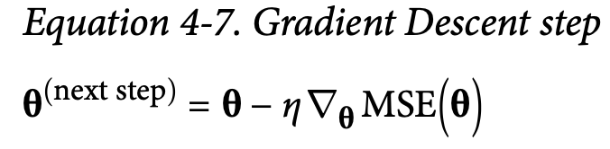
Batch Gradient Descent
To implement Gradient Descent, you need to compute the gradient of the cost function with regards to each model parameter θj. multiply the gradient vector by η to determine the size of the downhill step.

Slide 17
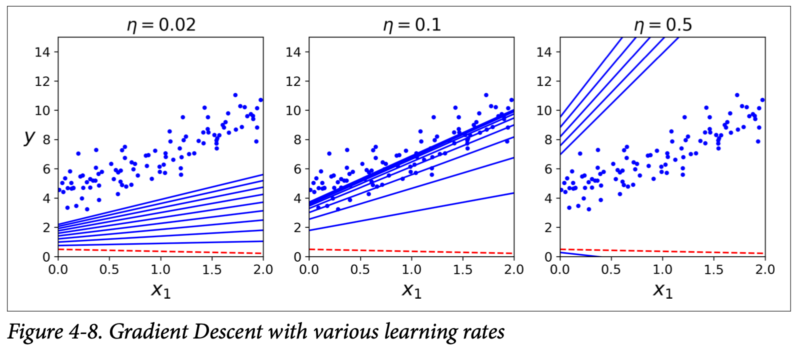

Slide 18
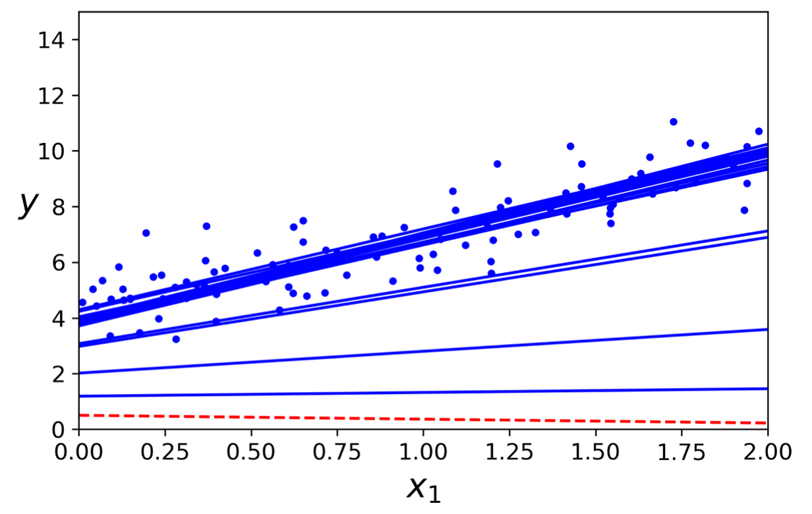
Stochastic Gradient Descent
The main problem with Gradient Descent is the fact that it uses the whole training set to compute the gradients at every step, which makes it very slow when the training set is large.
At the opposite extreme, Stochastic Gradient Descent just picks a random instance in the training set at every step and computes the gradients based only on that single instance. Obviously this makes the algorithm much faster since it has very little data to manipulate at every iteration.

Slide 19
Stochastic Gradient Descent
On the other hand, due to its stochastic (i.e., random) nature, this algorithm is much less regular than Batch Gradient Descent: instead of gently decreasing until it reaches the minimum, the cost function will bounce up and down, decreasing only on aver‐ age. Over time it will end up very close to the minimum, but once it gets there it will continue to bounce around, never settling down.
One solution to this dilemma is to gradually reduce the learning rate. The steps start out large (which helps make quick progress and escape local minima), then get smaller and smaller, allowing the algorithm to settle at the global minimum.

Slide 20
Stochastic Gradient Descent
from sklearn.linear_model import SGDRegressor
sgd_reg = SGDRegressor(max_iter=1000, tol=1e-3, penalty=None, eta0=0.1)
sgd_reg.fit(X, y.ravel())
To perform Linear Regression using SGD with Scikit-Learn, you can use the SGDRegressor class, which defaults to optimizing the squared error cost function.
The above code runs for maximum 1000 epochs (max_iter=1000) or until the loss drops by less than 1e-3 during one epoch (tol=1e-3), starting with a learning rate of 0.1 (eta0=0.1), using the default learning schedule (different from the preceding one), and it does not use any regularization (penalty=None):

Slide 21
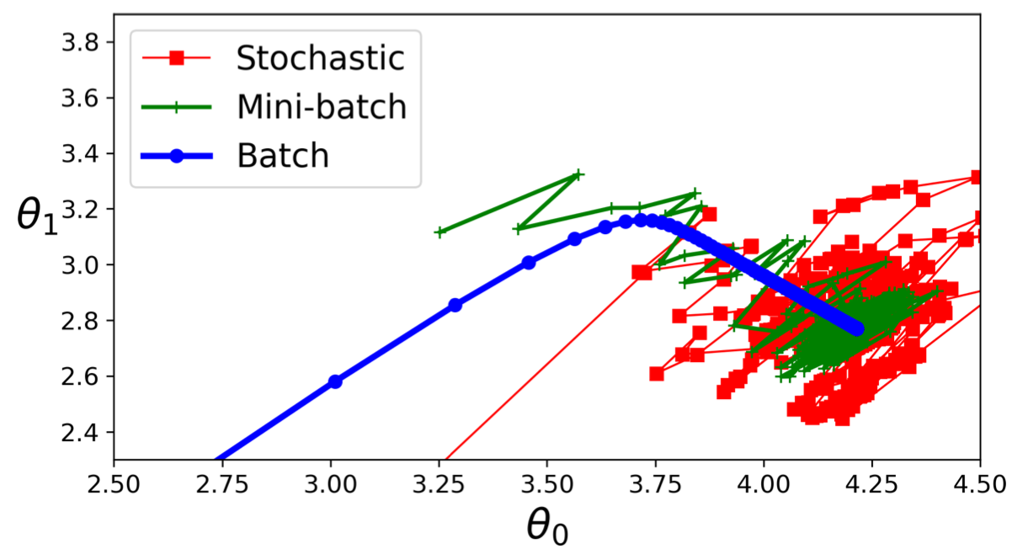
Mini-batch Gradient Descent
instead of computing the gradients based on the full training set (as in Batch GD) or based on just one instance (as in Stochastic GD), Mini-batch GD computes the gradients on small random sets of instances called mini-batches.
The main advantage of Mini-batch GD over Stochastic GD is that you can get a performance boost from hardware optimization of matrix operations, especially when using GPUs.

Slide 22
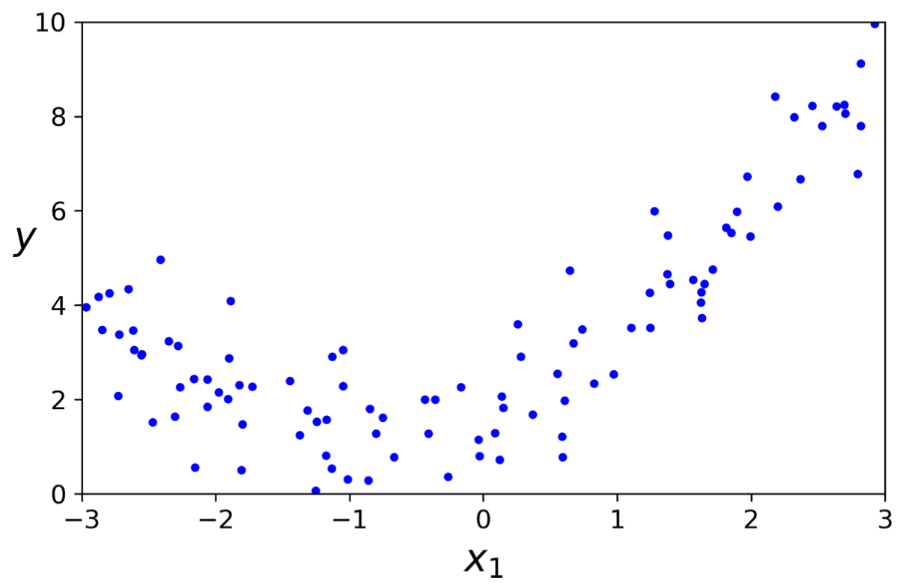
Polynomial Regression
Clearly, a straight line will never fit this data properly. So let’s use Scikit-Learn’s PolynomialFeatures class to transform our training data, adding the square (2nd-degree polynomial) of each feature in the training set as new features.

Slide 23
Polynomial Regression
>>> from sklearn.preprocessing import PolynomialFeatures
>>> poly_features = PolynomialFeatures(degree=2, include_bias=False)
>>> X_poly = poly_features.fit_transform(X)
>>> X[0]
array([-0.75275929])
>>> X_poly[0]
array([-0.75275929, 0.56664654])

Slide 24
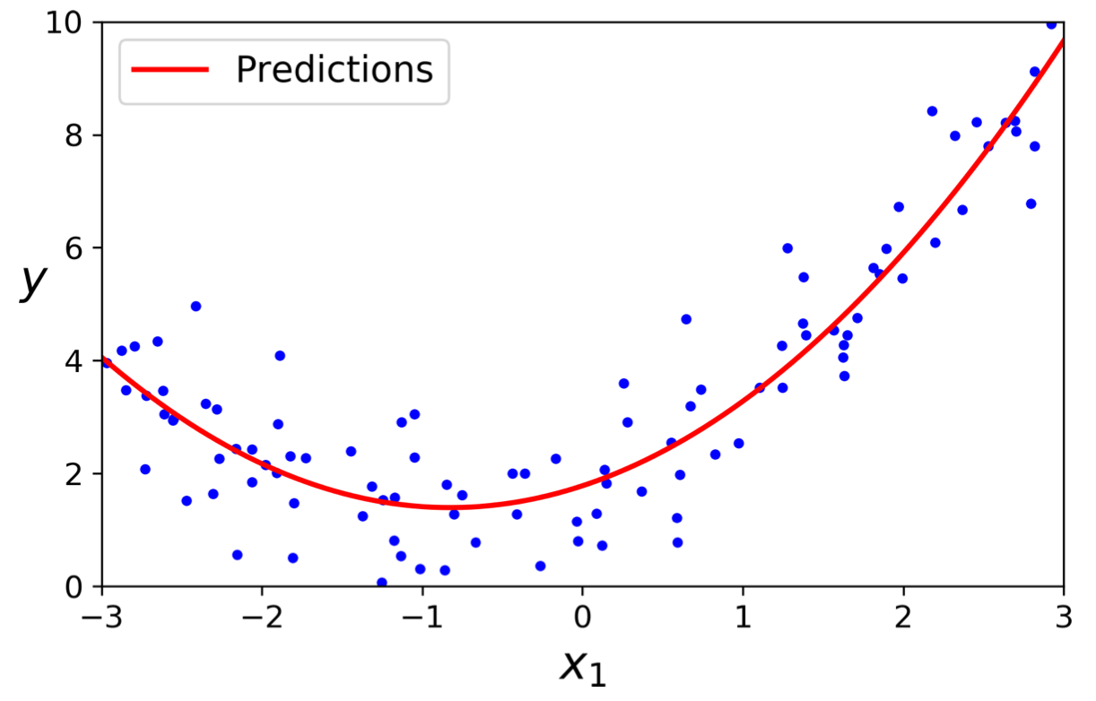
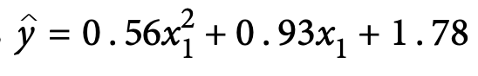
Polynomial Regression
>>> lin_reg = LinearRegression()
>>> lin_reg.fit(X_poly, y)
>>> lin_reg.intercept_, lin_reg.coef_
(array([1.78134581]), array([[0.93366893, 0.56456263]]))

Slide 25
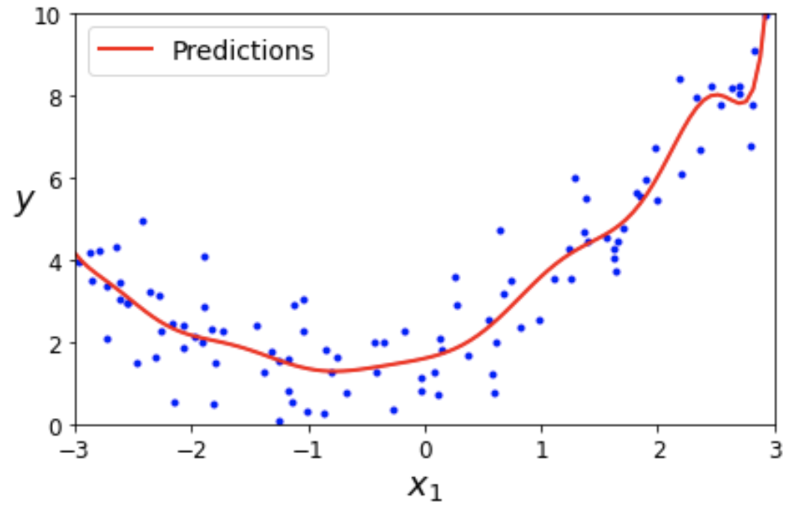
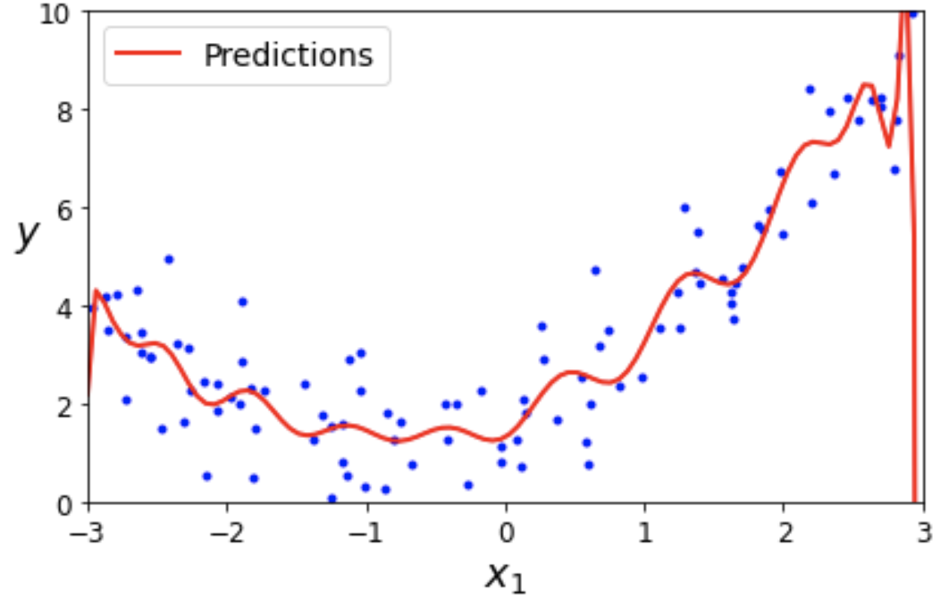
Polynomial Regression
If you perform high-degree Polynomial Regression, you will likely fit the training data much better than with plain Linear Regression.

Slide 26
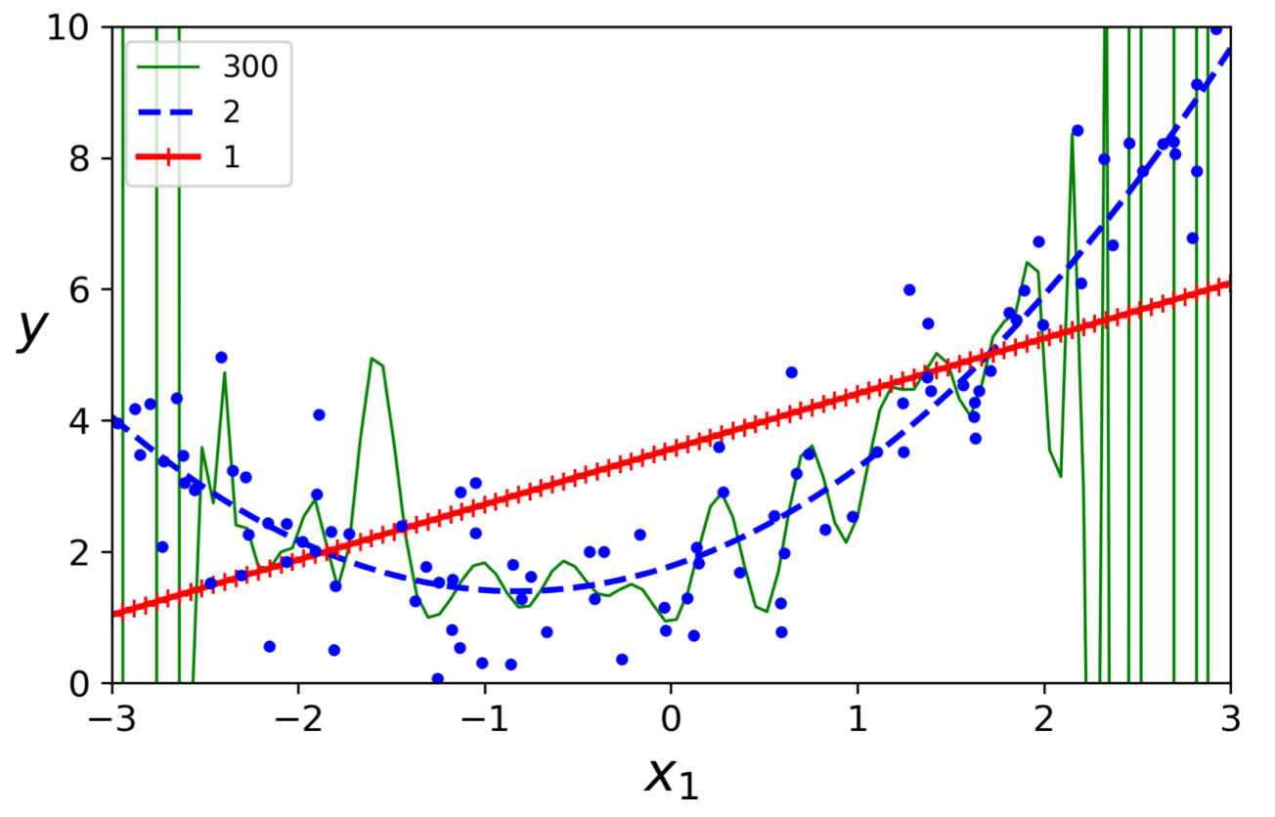

Slide 27
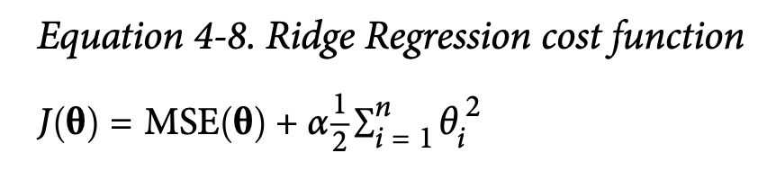
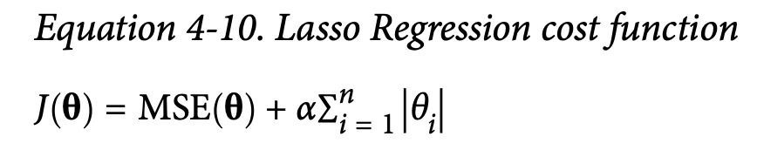
Further reading - Regularization
a good way to reduce overfitting is to regularize the model (i.e., to constrain it): the fewer degrees of freedom it has, the harder it will be for it to overfit the data.
A regularization term is added to the cost function. This forces the learning algorithm to not only fit the data but also keep the model weights as small as possible

Slide 28
Logistic Regression
Logistic Regression (also called Logit Regression) is commonly used to estimate the probability that an instance belongs to a particular class (e.g., what is the probability that this email is spam?).
If the estimated probability is greater than 50%, then the model predicts that the instance belongs to that class (called the positive class, labeled “1”), or else it predicts that it does not (i.e., it belongs to the negative class, labeled “0”). This makes it a binary classifier.

Slide 29
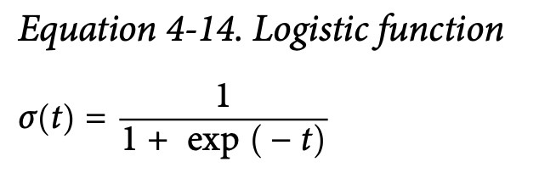
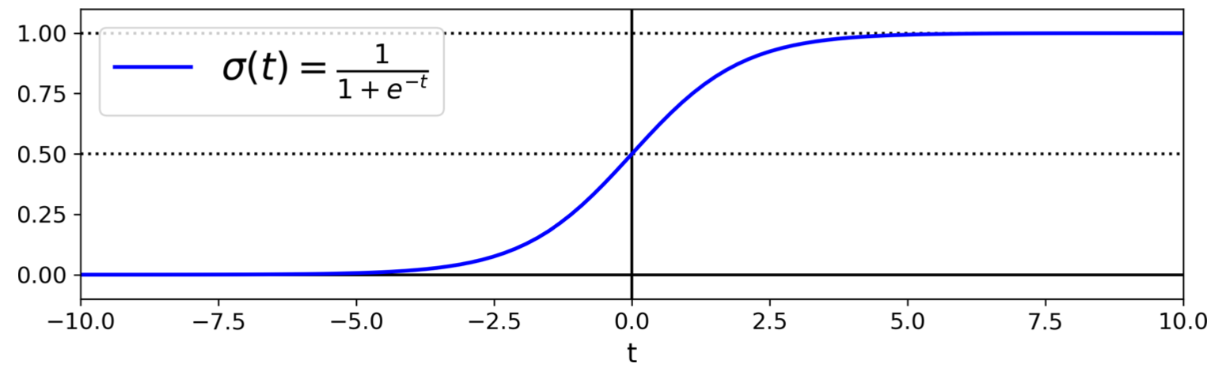
Estimating Probabilities
Instead of outputting the result directly like the Linear Regression model does, it outputs the logistic of this result.
The logistic—noted σ(·)—is a sigmoid function (i.e., S-shaped) that outputs a number between 0 and 1.

Slide 30
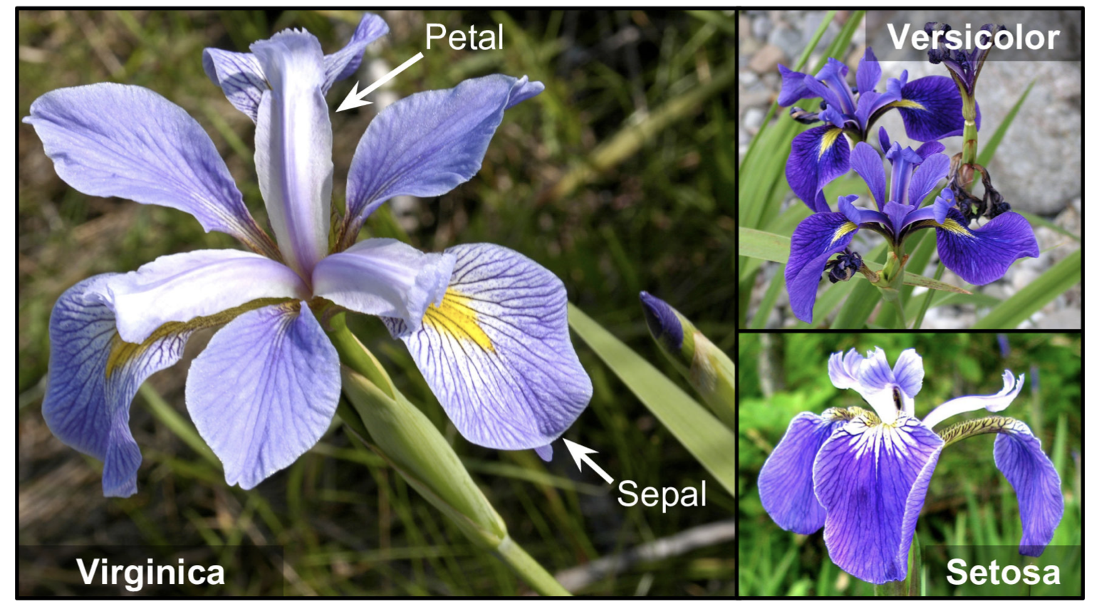
Decision Boundaries
Let’s use the iris dataset to illustrate Logistic Regression. This is a famous dataset that contains the sepal and petal length and width of 150 iris flowers of three different species: Iris-Setosa, Iris-Versicolor, and Iris-Virginica.

Slide 31
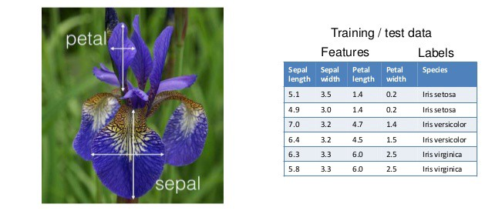
Decision Boundaries

Slide 32
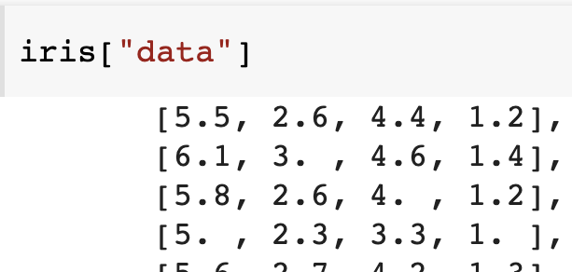
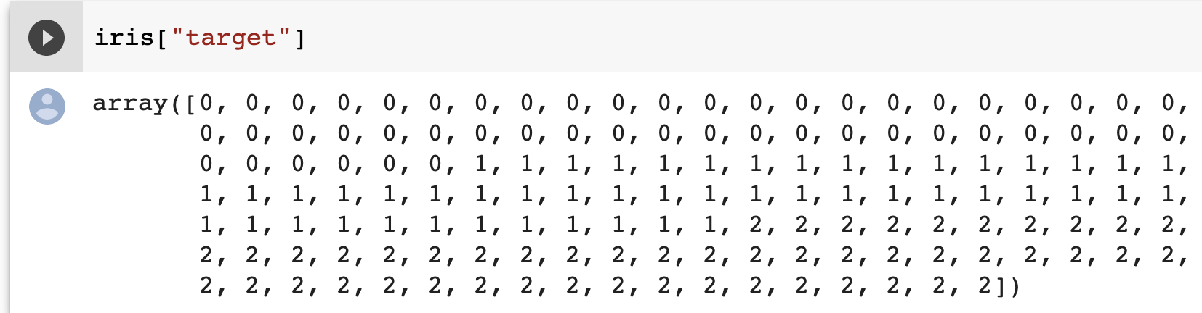
Decision Boundaries
Let’s try to build a classifier to detect the Iris-Virginica type based only on the petal width feature. First let’s load the data:
>>> from sklearn import datasets
>>> iris = datasets.load_iris()
>>> list(iris.keys())
['data', 'target', 'target_names', 'DESCR', 'feature_names', 'filename’]
>>> X = iris["data"][:, 3:] # petal width
>>> y = (iris["target"] == 2).astype(np.int) # 1 if Iris-Virginica, else 0

Slide 33
Decision Boundaries
Now let’s train a Logistic Regression model:
from sklearn.linear_model import LogisticRegression
log_reg = LogisticRegression()
log_reg.fit(X, y)

Slide 34
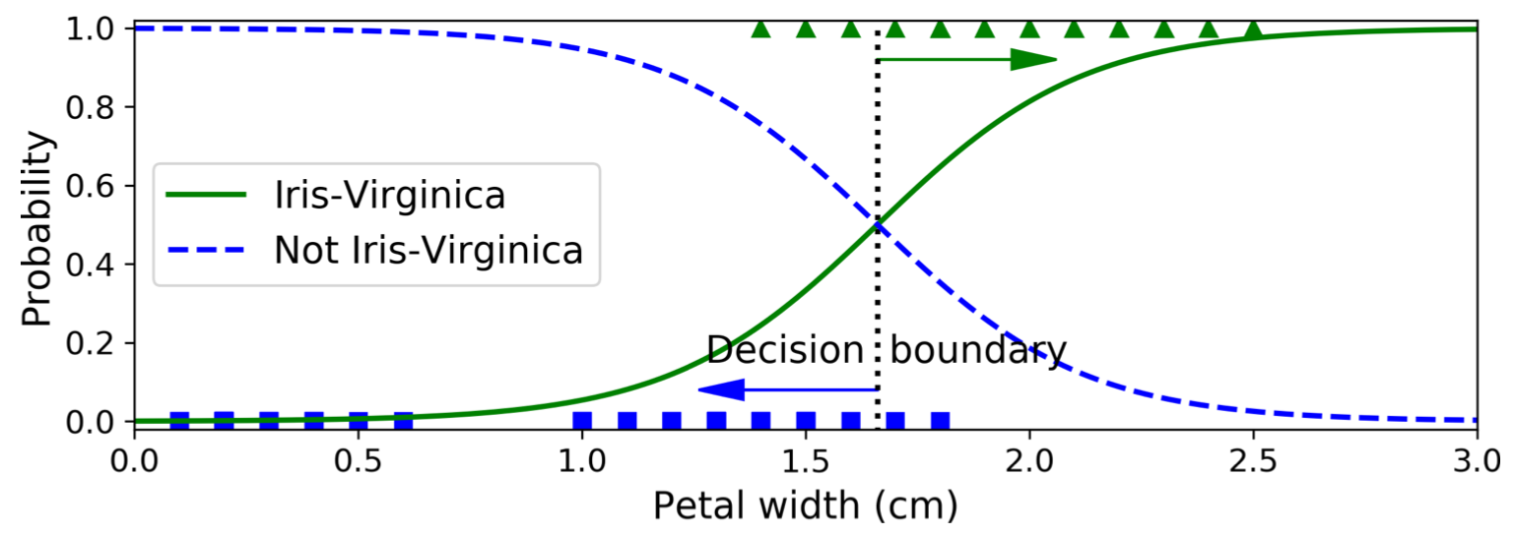
Decision Boundaries
Let’s look at the model’s estimated probabilities for flowers with petal widths varying from 0 to 3 cm
X_new = np.linspace(0, 3, 1000).reshape(-1, 1)
y_proba = log_reg.predict_proba(X_new)
plt.plot(X_new, y_proba[:, 1], "g-", label="Iris-Virginica")
plt.plot(X_new, y_proba[:, 0], "b--", label="Not Iris-Virginica")

Slide 35
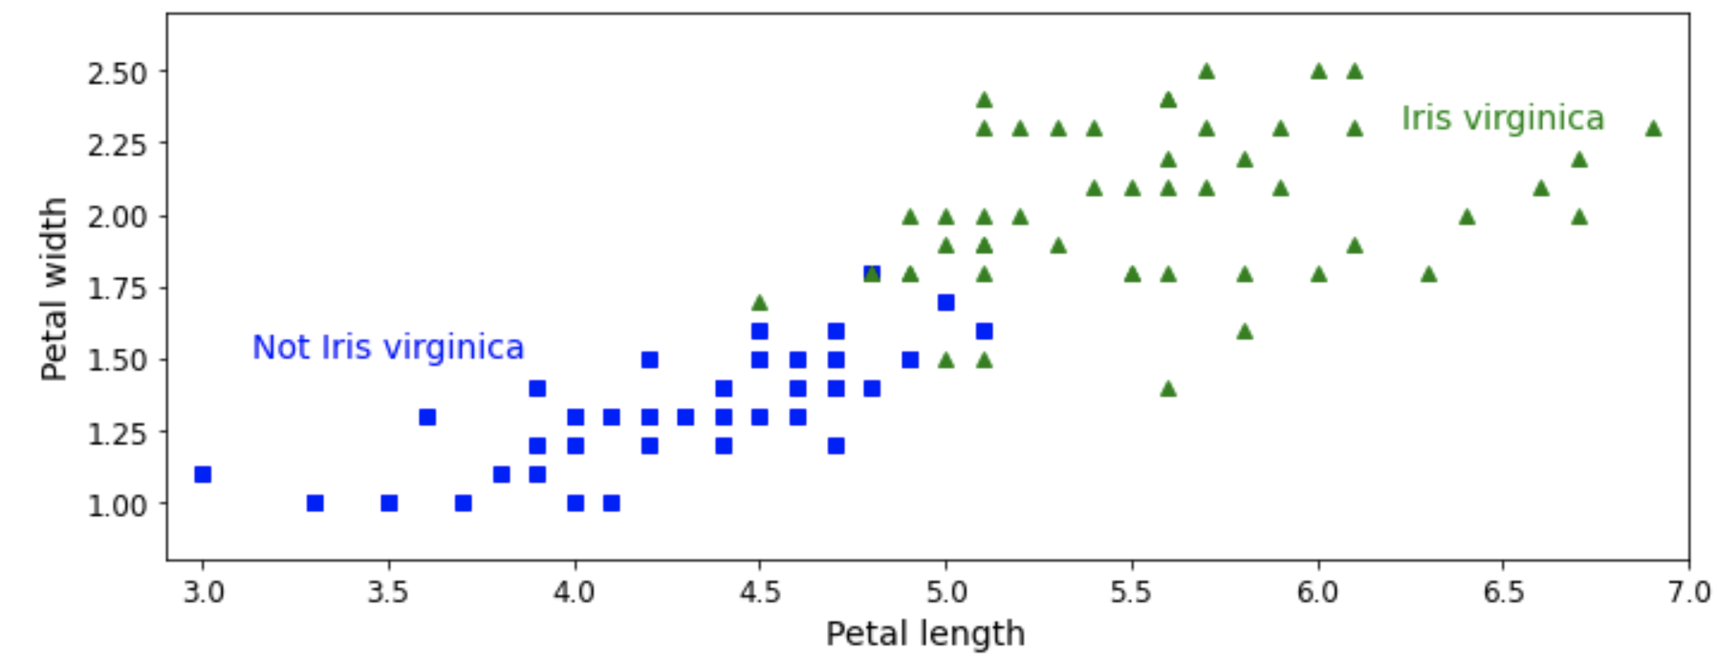
Decision Boundaries

Slide 36
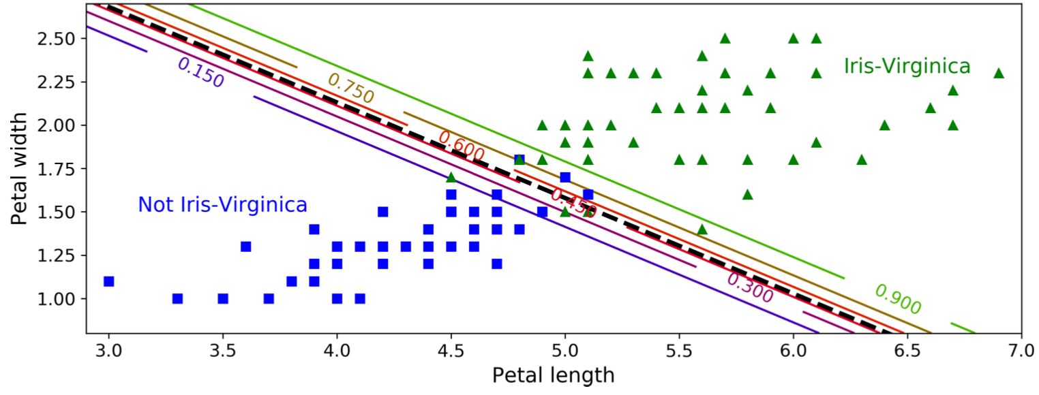
Decision Boundaries
Model based on two features: petal width and length. The dashed line represents the points where the model estimates a 50% probability: this is the model’s decision boundary.
Each parallel line represents the points where the model outputs a specific probability, from 15% (bottom left) to 90% (top right).

Slide 37
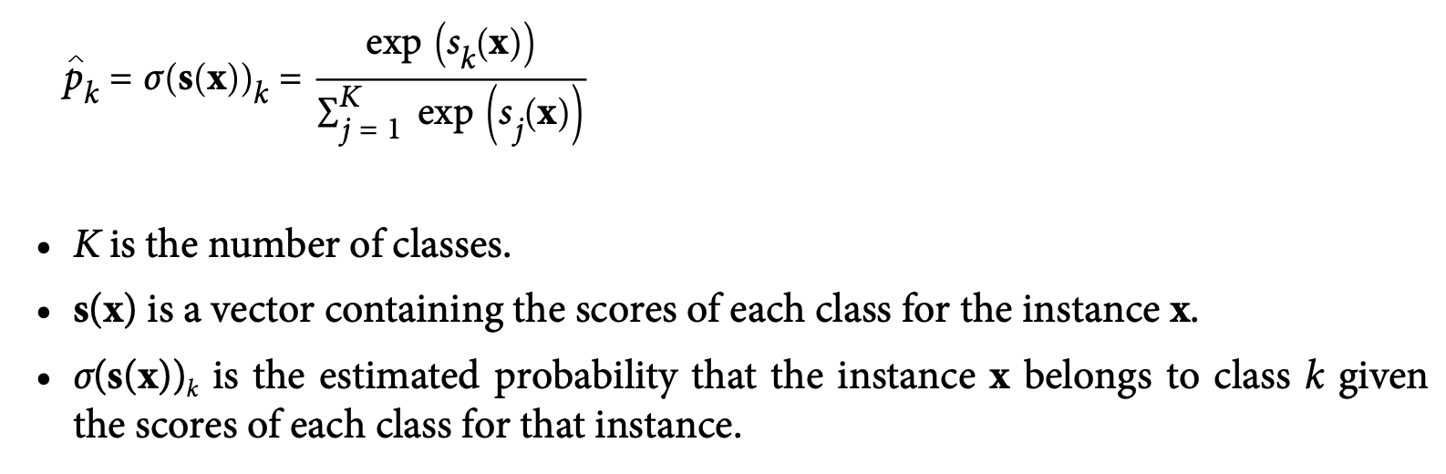
Softmax Regression
The Logistic Regression model can be generalized to support multiple classes: Softmax Regression.
The idea is : when given an instance x, the Softmax Regression model first computes a score s_{k}(x) for each class k, then estimates the probability of each class by applying the Softmax function (aka normalized exponential) to the scores.
it computes the exponential of every score, then normalizes them (dividing by the sum of all the exponentials)

Slide 38
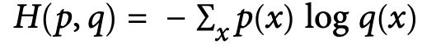
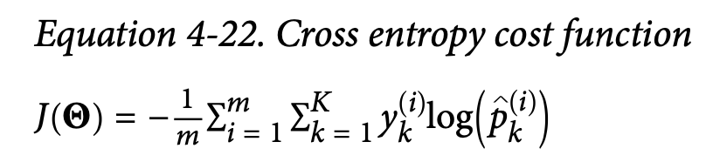
Softmax Regression
Futher readling: https://homl.info/xentropy
Cross entropy is frequently used to measure how well a set of estimated class probabilities match the target classes.
The cross entropy between two probability distributions p and q is defined as

Slide 39
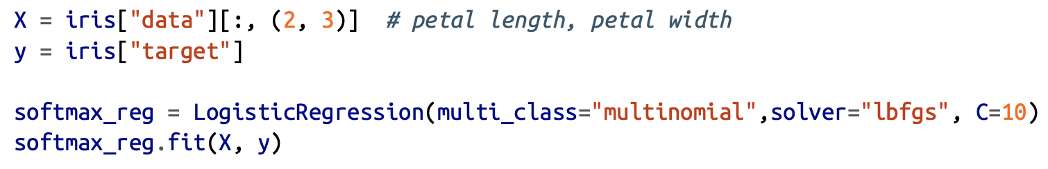
Softmax Regression
Use Softmax Regression to classify the iris flowers into all three classes. Set the multi_class hyperparameter to "multinomial" to enable Softmax Regression.
Specify a solver that supports Softmax Regression, such as the "lbfgs" solver. It also applies l2 regularization by default, which you can control using the hyperparameter C.

Slide 40
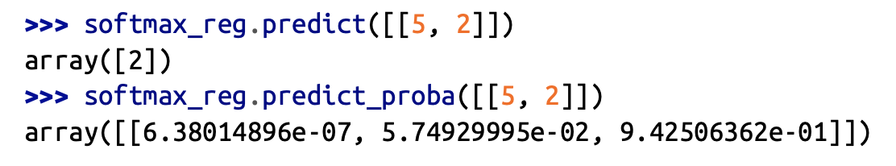
Softmax Regression
So the next time you find an iris with 5 cm long and 2 cm wide petals, you can ask your model to tell you what type of iris it is, and it will answer Iris-Virginica (class 2) with 94.2% probability (or Iris-Versicolor with 5.8% probability):

Slide 41
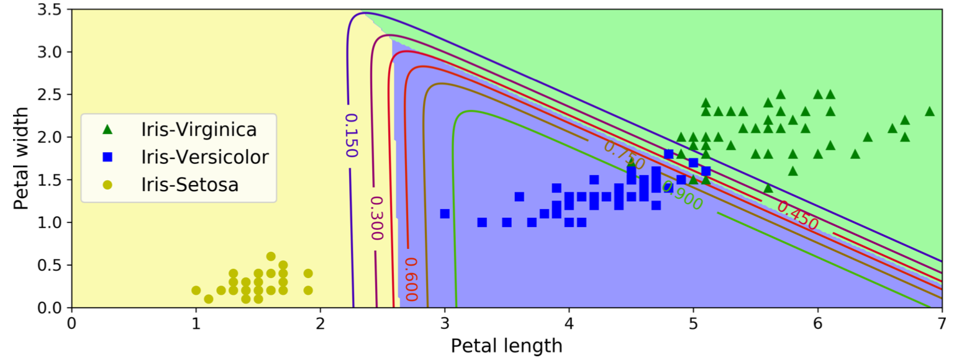
Softmax Regression

